Slide 1
Murach’s C# (8th Edition)
Chapter 19
An introduction to database programming

Slide 2
Objectives
Knowledge
Describe the hardware components of a typical multi-user system.
Describe the software components of a typical multi-user database app.
Explain how a table in a relational database is organized.
Explain how the tables in a relational database are related.
Describe the use of these SQL statements: SELECT, INSERT, UPDATE, and DELETE.

Slide 3
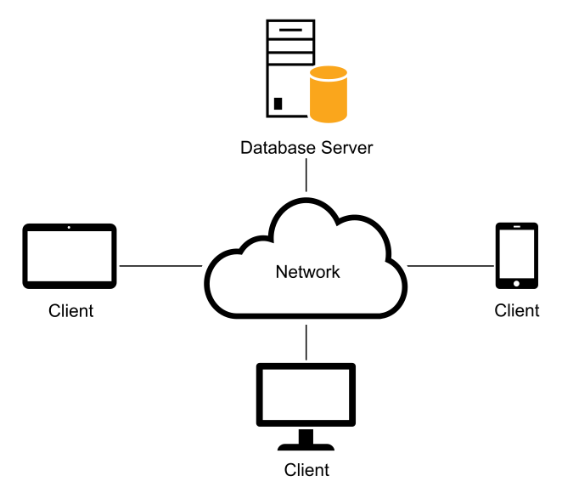
The diagram of a simple client/server system

Slide 4
The three hardware components of a client/server system
The clients are the personal computers or mobile devices of the system.
The server is a computer that stores the files and databases of the system and provides services to the clients.
The network consists of the cabling, communication lines, and other components that connect the clients and the servers.

Slide 5
Client/server system implementations
In a simple client/server system, the server communicates with the clients over a local area network (LAN).
LANs can be connected and share data over larger private networks such as a wide area network (WAN) or the internet.
When a system consists of a private network and servers over a wide area, it is commonly called an enterprise system.

Slide 6
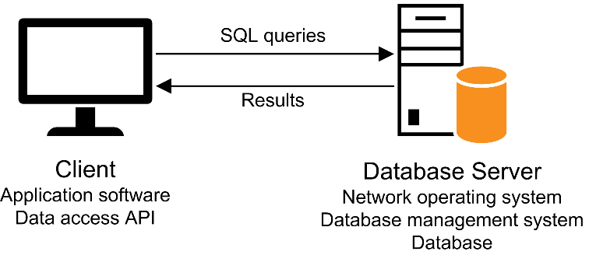
A diagram of the client software, the server software, and the SQL interface

Slide 7
Server terms
To manage the network, the server runs a network operating system such as Windows Server.
To store and manage the databases of the client/server system, each server requires a database management system (DBMS).
The processing that’s done by the DBMS is typically referred to as back-end processing.
The database server is typically referred to as the back end.

Slide 8
Client terms
The application software does the work that the user wants to do. This type of software can be purchased or developed.
The data access API (application programming interface) provides the interface between the app and the DBMS.
The processing that’s done by the client software is typically referred to as front-end processing.
The client is typically referred to as the front end.
Microsoft’s data access APIs are Entity Framework (EF) Core and ADO.NET.

Slide 9
The SQL interface
The application software communicates with the DBMS by sending SQL queries through the data access API.
When the DBMS receives a query, it provides a service like returning the requested data (the query results) to the client.
SQL, which stands for Structured Query Language, is the standard language for working with a relational database.

Slide 10
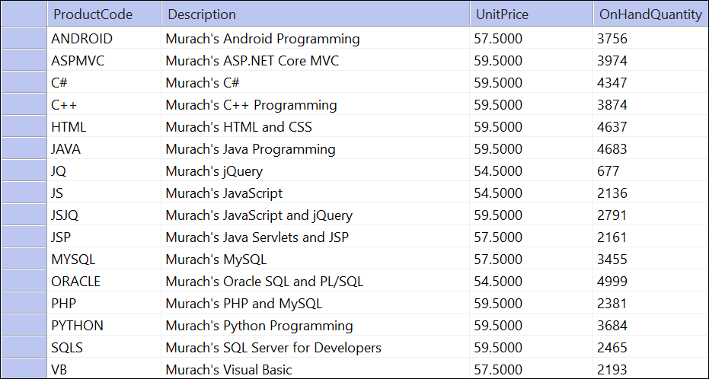
The Products table in the MMABooks database

Slide 11
How a table is organized
A relational database uses tables to store and manipulate data.
Each table consists of one or more records, or rows, that contain the data for a single entry.
Each row contains one or more fields, or columns, with each column representing a single item of data.
Most tables contain a primary key that uniquely identifies each row in the table.
Some database management systems let you define one or more non-primary keys.
In SQL Server, non-primary keys are called unique keys, and they’re implemented using unique key constraints.
A table can also be defined with one or more indexes. An index is automatically created for a table’s primary and non-primary keys.

Slide 12
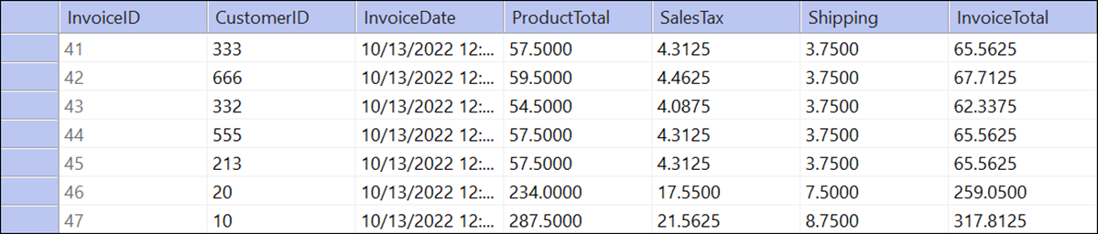
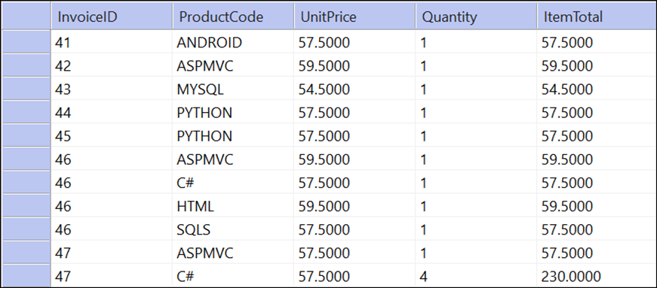
Two related tables
Invoices
InvoiceLineItems

Slide 13
How the tables in a database are related
The tables in a relational database are related to each other through their key columns.
A column that identifies a related row in another table is called a foreign key.
The table with the foreign key is the foreign key table, and the table with the primary key is the primary key table.
The most common type of relationship is a one-to-many relationship.
A table can also have a one-to-one relationship or a many-to-many relationship with another table.

Slide 14
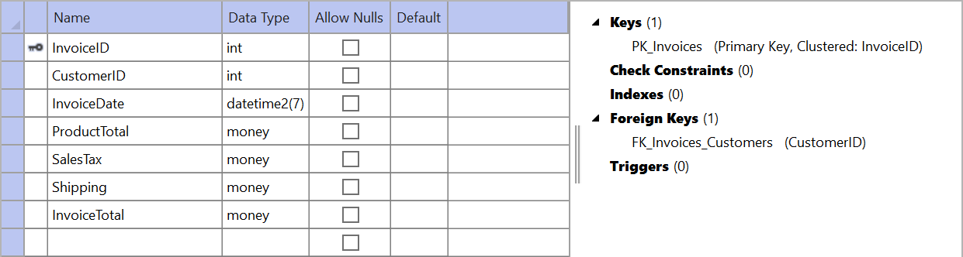
The SQL Server Object Explorer design view window for the Invoices table

Slide 15
Common SQL Server data types
bit
char, varchar, nchar, nvarchar
date, time, datetime2
decimal, numeric
float, real
bigint, int, smallint, tinyint
money, smallmoney

Slide 16
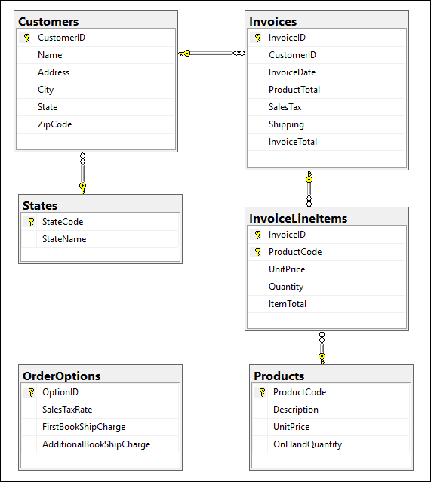
A diagram of the MMABooks database

Slide 17
A SELECT statement that retrieves and sorts data from the Customers table
SELECT Name, City
FROM Customers
WHERE State = 'WA'
ORDER BY Name

Slide 18
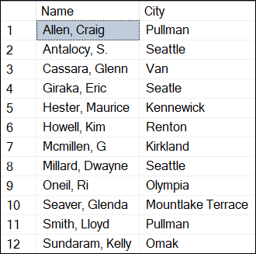
The sorted result set

Slide 19
Terms for querying a single table
The result of a SELECT statement is a result table, or result set.
The SELECT clause lists the columns to be included in the result set. This list can include calculated columns.
The FROM clause names the table the data will be retrieved from.
The WHERE clause provides a condition that specifies which rows should be retrieved.
To retrieve all rows from a table, omit the WHERE clause.
The ORDER BY clause lists the sort columns and indicates whether the sequence is ascending or descending.
To select all columns in a table, you can code an asterisk (*) in place of the column names.

Slide 20
A SELECT statement that joins data from the InvoiceLineItems and Products tables
SELECT InvoiceLineItems.InvoiceID, InvoiceLineItems.ProductCode, Products.Description, InvoiceLineItems.UnitPrice, InvoiceLineItems.Quantity FROM InvoiceLineItems INNER JOIN Products ON InvoiceLineItems.ProductCode = Products.ProductCode WHERE InvoiceLineItems.InvoiceID = 46

Slide 21
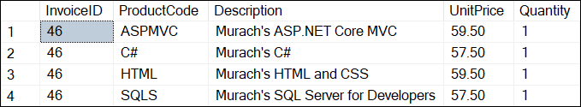
The joined result set

Slide 22
A SELECT statement that uses aliases for table names
SELECT li.InvoiceID, li.ProductCode, p.Description, li.UnitPrice, li.Quantity FROM InvoiceLineItems AS li INNER JOIN Products AS p ON li.ProductCode = p.ProductCode WHERE li.InvoiceID = 46

Slide 23
Terms for joining join data from two or more tables
A join lets you combine data from two or more tables into a single result set.
The most common type of join is an inner join. This type of join returns rows from both tables only if their related columns match.
You can make your SQL statements more readable by using aliases for table names.

Slide 24
A statement that adds a single row to the Products table
INSERT
INTO Products (ProductCode, Description,
UnitPrice, OnHandQuantity)
VALUES ('R', 'Murach''s R for Data Analysis',
59.50, 3000)

Slide 25
A statement that updates the UnitPrice column for a specified product
UPDATE Products
SET UnitPrice = 54.00
WHERE ProductCode = 'MYSQL'

Slide 26
A statement that deletes a specified customer
DELETE FROM Customers
WHERE CustomerID = 558

